Slide 1
Semiconductors

Slide 2
Conductivity of materials
Conductivity is proportional to the concentration n of free electrons
A good conductor: n ≈ 10²⁸ electrons / m³
An insulator: n ≈ 10⁷ electrons / m³
semiconductors are materials which have a conductivity between conductors and nonconductors or insulators
Semiconductors are made from pure elements, typically silicon or geranium, or compounds such as gallium arsenide.

Slide 3
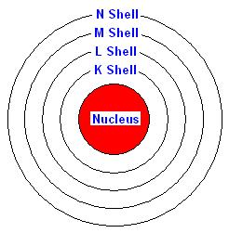
Conductivity is caused by movement of free electrons
Electrons are moving around the nucleus in different shells
Shells are divided in subshells
The maximum no of electrons that in be present in a shell or subshell is fixed
Electron shell and subshells
shell | K | L |  | M |  |  | N
n | 1 | 2 |  | 3 |  |  | 4
l | 0 | 0 | 1 | 0 | 1 | 2 | 0 | 1 | 2 | 3
subshell | s | s | p | s | p | d | s | p | d | f
No of Electrons | 2 | 2 | 6 | 2 | 6 | 10 | 2 | 6 | 10 | 14
 | 2 | 8 |  | 18 |  |  | 32

Slide 4
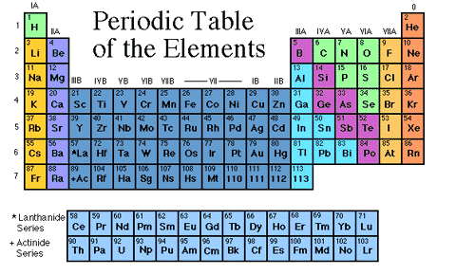
Who are semiconductors?

Slide 5
Availability of free electrons is dependent on the element
Electronic configuration in Group IV A
Element | Atomic number | Configuration
C | 6 | 1s² 2s² 2p²
Si | 14 | 1s² 2s² 2p⁶3s² 3p²
Ge | 32 | 1s² 2s² 2p⁶3s² 3p⁶3d¹⁰4s² 4 p²
Sn | 50 | 1s² 2s² 2p⁶3s² 3p⁶3d¹⁰4s² 4 p⁶4d¹⁰5s² 5p²
C, Si, Ge, Sn are in same Group IV A in periodic table
Each has completely filled subshells except for outermost p subshell having only two of six possible electrons
C in crystalline form: an insulator
Si, Ge: semiconductors
Sn: metal

Slide 6
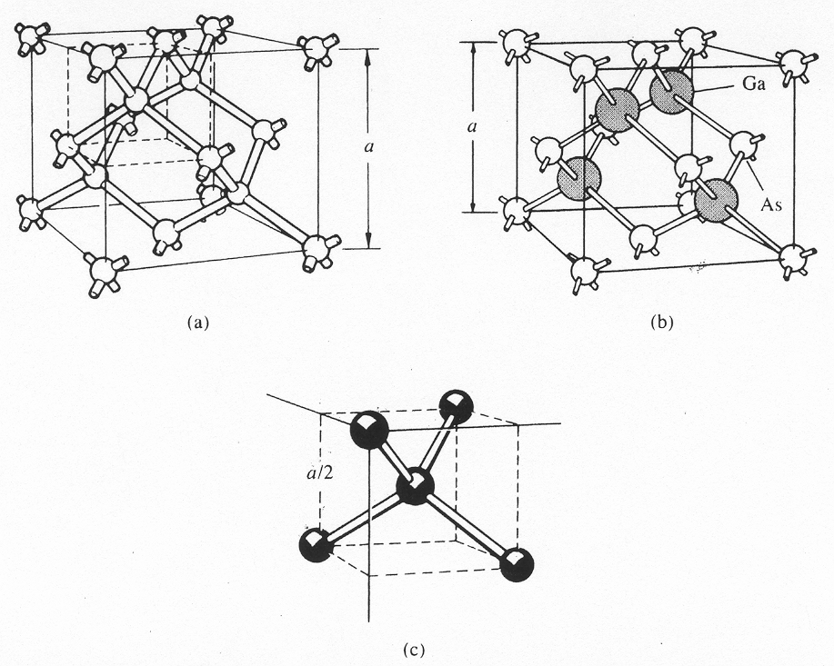
Most metals and semiconductors are crystalline in structure
Diamond Lattice
Tetrahedral structure
4 nearest neighbors
A crystal consists of a space array of atoms built up by regular repetition in three dimensions of some fundamental structural unit
The characteristics at any point is the result of contributions from every atom

Slide 7
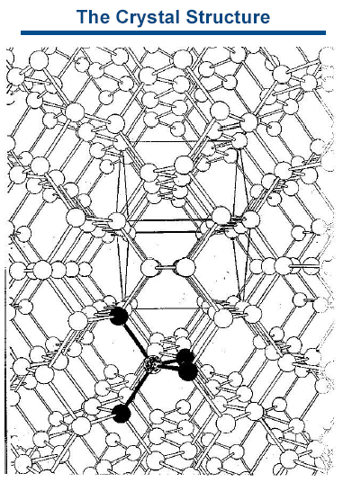
A crystal consists of a space array of atoms built up by regular repetition in three dimensions of some fundamental structural unit
The characteristics at any point is the result of contributions from every atom

Slide 8
Most metals and semiconductors are crystalline in structure
The energy levels of inner shell electrons are not affected appreciably by the presence of neighboring atoms
The levels of the outer shell electrons are changed considerably, since they are shared by more than one atom in the crystal

Slide 9
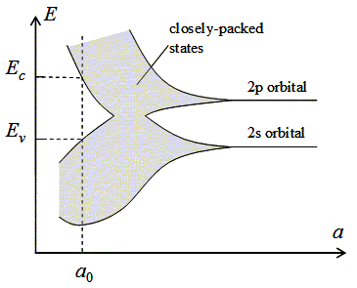
Energy Band Theory of Crystals
Energy
Imagine that the spacing between atoms may vary
Inner shell atomic energy levels unaffected by crystal formation
Energy band
Interatomic spacing
If atoms are far away, interaction between them is negligible, energy levels coincide with those of isolated atom
If interatomic spacing decreases,
(i) An atom will exert an electric force on its neighbors.
(ii) The crystal becomes an electronic system (follow Pauli exclusion principle)
(iii) s and p states spread out in energy
As no of atoms per cm³ is very large (~10²³), the total spread between minimum and maximum energy may be several electron volts (energy band)

Slide 10
Energy Band Theory of Crystals
Energy
Valence band
Interatomic spacing
For small enough distance
(i) the bands overlap
(ii) each atom gives up 4 electrons;
These electrons can no longer be in s or p subshell, they belong to the crystal as a whole
The band these electrons occupy is called as valence band

Slide 11
Energy Band Theory of Crystals
If interatomic spacing decreases further, say below the distance at which the bands overlap, the interaction between atoms become very large
The energy band structure becomes dependent upon
(i) orientation of the atoms relative to another in space (crystal structure)
(ii) atomic number
Energy
E_{g}
Crystal lattice spacing
Interatomic spacing
Behavior follows Schrodinger’s equation
At the crystal lattice spacing a₀, valence band is filled with 4 electrons separated by a forbidden band (no allowed energy state) of extent E_{g} from an empty band
The upper vacant band is called conduction band

Slide 12
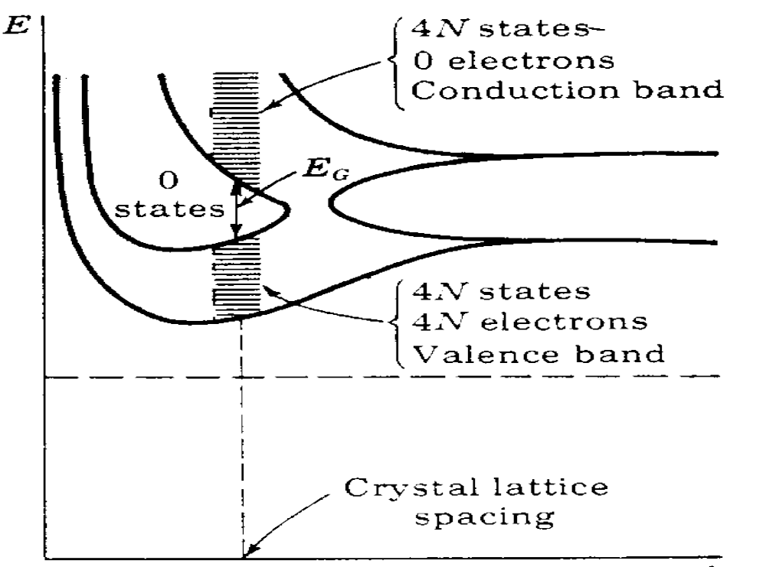
Energy Bands in Semiconductors
Let there be N atoms in the crystal
The space between the bands is the energy gap, or forbidden band

Slide 13
Energy Band Structure
Conduction band
The large forbidden band
For diamond (carbon) crystal, E_{g} ≈ 6ev
The energy that can be supplied to an electron is too small to carry it to conduction band from the filled into valance band
E_{g} ≈ 6ev
Valence band
Insulator
Free electrons
Holes
The small forbidden band. Behaves like insulator at low temperature
E_{g} = 0.72 (1.21) ev for Ge (Si) at room temperature
Energies of this magnitude cannot be supplied by an electric field
If the temperature increases, some elctrons from valence band jump into the empty conduction band to become free electrons
The absence of an electron in valence band creats a hole
Conduction band
E_{g} ≈ 1ev
Valence band
Semiconductor
Conduction band
No forbidden band.
Valence band merges into empty band
Under influence of an electric field the elctrons acquire additional energy and move into higher energy states to constitute a current
Valence band
Metal

Slide 14
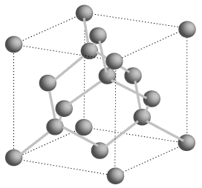
Electrons and holes in semiconductor
Crystal structure of semiconductor consists of a space array of atoms built up by regular repetition in three dimensions of a unit cell having the form of an tetrahedron
For ease of understanding, let the crystal structure of semiconductor is symbolically illustrated in two dimensions
Si
Si
Si
The inert core of Si atom carries a positive charge of + 4
Each of the valence electron of a Si atom is shared by one of its nearest neighbours
This electron pair forms covalent bond
Valence becomes tightly bound to nucleus
At low temperature (say 0⁰ K), the crystal becomes an insulator
Si
+4
+4
+4
Si
Si
Si
+4
+4
+4
Si
Si
+4
+4
+4
Si
Si
Si
Si

Slide 15
Electrons and holes in semiconductor
free electron
At room temperature, some of the covalent bonds will be broken
Some electrons may be dislodged to become free to wander in random fashion throughout the crystal
Absence of electron in covalent bond is called a hole
When a hole exists, a valence electron in neighboring atom may leave its covalent bond to fill this hole – thus the hole moves
This hole in new position may now be filled by an electron from another covalent bond, causing further movement of hole
hole
Si
Si
Si
Si
+4
+4
+4
Si
Si
Si
+4
+4
+4
Si
Si
+4
+4
+4
Si
Si
Si
Si
Conduction of electricity is possible without involving free electrons

Slide 16
Donor impurity in semiconductor
free electron
Si
Si
Si
A small amount of impurity with 5 valence electrons is added
Four of five valence electrons occupy covalent bonds, the fifth is unbound and becomes free
The type of impurity is donor, as it donates electrons
It is called n-type semiconductor
Suitable pentavalent impurites: P, Sb, As
Si
+4
+4
+4
Si
P
Si
+4
+5
+4
Si
Si
+4
+4
+4
Si
Si
Si
Si
Allowable energy levels are introduced a very small distance [(0.01 {0.05} ev for Ge {Si}),] below conduction band
This new allowable level is discrete, as added impurity atoms are far apart in crystal structure, their interaction is small
Energy required to detach this fifth electron from atom to raise it in conduction band is only 0.01 {0.05} ev for Ge {Si},
The presence of large no of electrons increases rate of recombination of holes and electrons, thus decreases the no of holes below that is available in intrinsic semiconductor
Conduction band
E_{c}
E_{d}
E_{g} ≈ 1ev
Donor energy level
E_{v}
Valence band
n-type Semiconductor

Slide 17
Acceptor impurity in semiconductor
hole
Si
Si
Si
A small amount of impurity with 3 valence electrons is added
Three valence electrons fill three covalent bonds, a vacancy exists in 4th bond, creating a hole that can accept electron
The type of impurity is acceptor, as it accepts electrons
It is called p-type semiconductor
Suitable trivalent impurites: B, Ga, In
Si
+4
+4
+4
Si
In
Si
+4
+3
+4
Si
Si
+4
+4
+4
Si
Si
Si
Si
Allowable energy levels are introduced which is just above valence band
This new allowable level is discrete, as added impurity atoms are far apart in crystal structure, their interaction is small
Very small amount of energy is required for an electron to leave valence band and occupy acceptor energy level
The presence of large no of holes increases rate of recombination of holes and electrons, thus decreases the no of electrons below that is available in intrinsic semiconductor
Conduction band
E_{c}
E_{g} ≈ 1ev
Acceptor energy level
E_{a}
E_{v}
Valence band
p-type Semiconductor

Slide 18
Result of doping in semiconductor
Increases conductivity
Produces conductors in which electric carriers are either predominantly holes or predominantly electrons
In n-type semiconductor, majority carrier is electrons and minority carrier is holes
In p-type semiconductor, majority carrier is holes and minority carrier is electrons
By combining n-type and p-type semiconductors materials that conduct only under certain conditions can be created

Slide 19
Semiconductor Diode
Acceptor ion
Junction
Donor ion
-
-
-
-
+
+
+
+
holes
electrons
-
-
-
-
+
+
+
+
-
-
-
-
+
+
+
+
-
-
-
-
+
+
+
+
p type
n type
Donor and acceptor impurities are introduced in two sides of a single crystal of semiconductor
By donating an electron a donor impurity atom becomes a positive ion
An acceptor impurity atom becomes a negative ion after accepting an electron
Holes diffuse to the right and electrons to the left across the junction
As holes and electrons combine across the junction, they disappear near the junction

Slide 20
Semiconductor Diode
Acceptor ion
Junction
Donor ion
-
-
-
-
+
+
+
+
holes
electrons
-
-
-
-
+
+
+
+
-
-
-
-
+
+
+
+
-
-
-
-
+
+
+
+
p type
n type
0.5 cm
An electric field appears across the junction
Equilibrium is established, when field is large enough to restrain the process of diffusion
For further movement of holes and electrons, they have to cross a potential barrier (i.e. we have to apply an external field)
Unneutralized ions in the neighborhood of the junction are uncovered charges
The region across is called space charge region or depletion region
Thickness of depletion region is very small (10⁻⁴ cm)

Slide 21
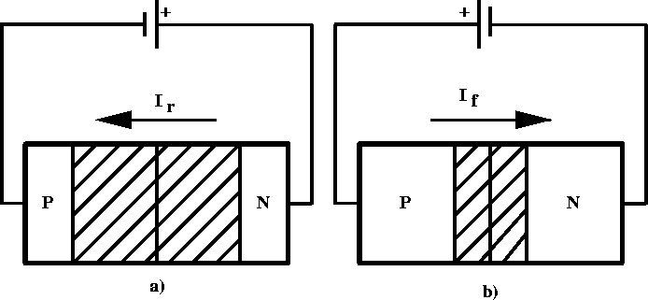
P-N Junction – Forward Bias
positive voltage placed on p-type material
holes in p-type move away from positive terminal, electrons in n-type move further from negative terminal
depletion region becomes smaller - resistance of device decreases
voltage increased until critical voltage is reached, depletion region disappears, current can flow freely
+

Slide 22
P-N Junction – Reverse Bias
positive voltage placed on n-type material
electrons in n-type move closer to positive terminal, holes in p-type move closer to negative terminal
width of depletion region increases
allowed current is essentially zero (small “drift” current)
+

Slide 23
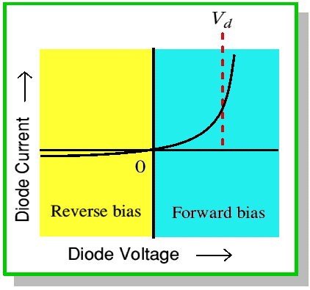
IV Characteristics of Diode

Slide 24
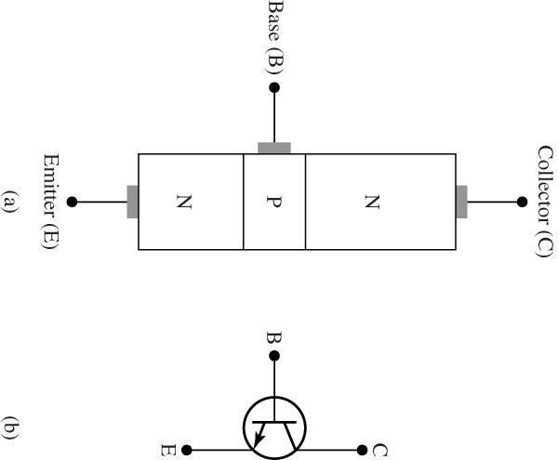
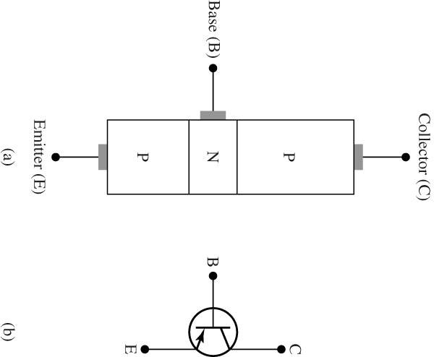
Semiconductor Transistor
n-type semiconductor is sandwiched between two layers of p-type
p-type semiconductor is sandwiched between two layers of n-type

Slide 25
Bipolar Junction Transistor (BJT)
base
base
Emitter
Emitter
collector
collector
n p n
p n p
Flow of electrons
Flow of holes
Currents flow mainly due to majority carriers

Slide 26
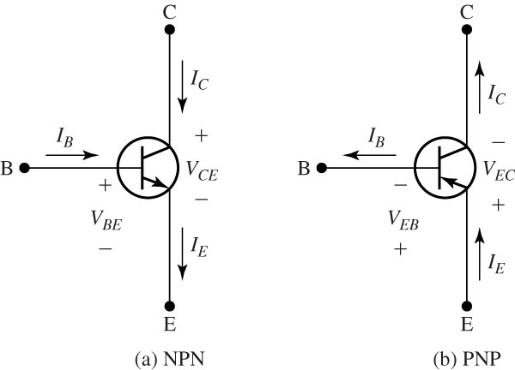
Reference positive directions for both NPN and PNP transistors.

Slide 27
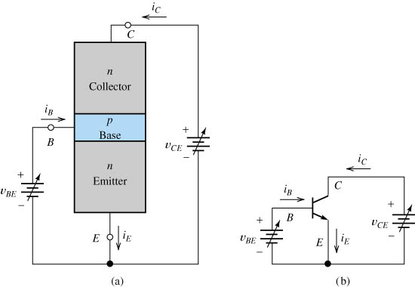
An npn transistor with variable biasing sources (common-emitter configuration).

Slide 28
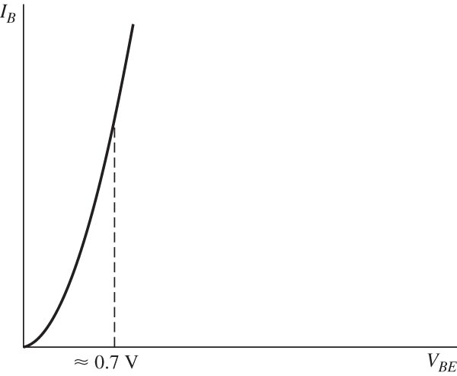
Base characteristic with collector-to-emitter voltage constant.

Slide 29
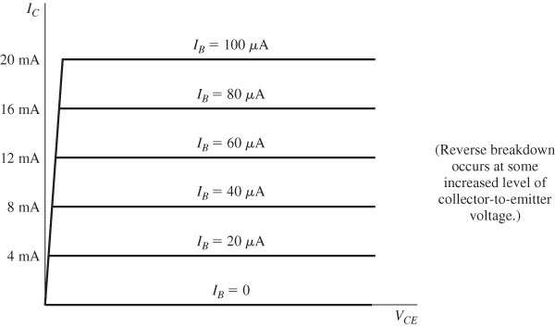
Collector characteristics of an ideal representative BJT.

Slide 30
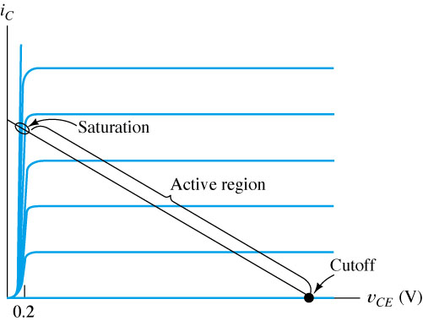
Three regions of operation for a BJT.
Amplification occurs in the active region. In saturation, v_{CE} < 0.2 V.

Slide 31
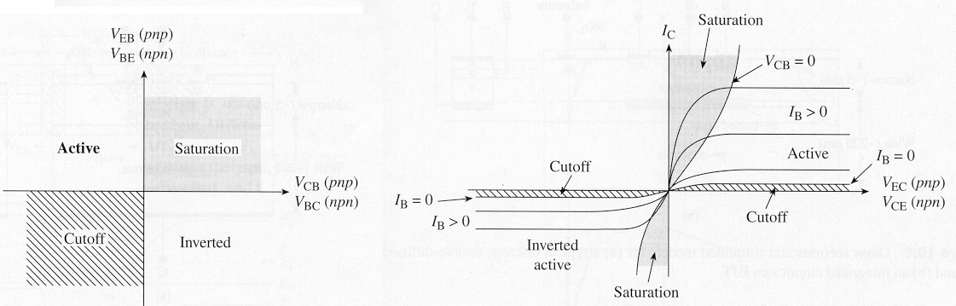
Modes of Operation
Common-emitter output characteristics
(I_{C} vs. V_{CE})
Mode | Emitter Junction | Collector Junction
CUTOFF | reverse bias | reverse bias
Forward ACTIVE | forward bias | reverse bias*
Reverse ACTIVE | reverse bias* | forward bias
SATURATION | forward bias | forward bias
*or not strongly forward biased

Slide 32
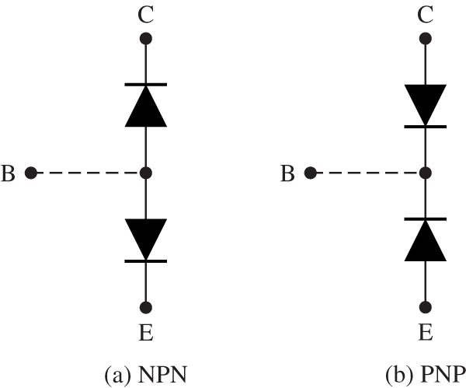
Models to assist in visualizing BJT as two diodes.

Slide 33
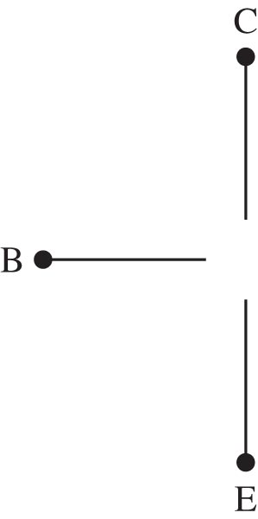
Ideal model of BJT in cutoff region.

Slide 34
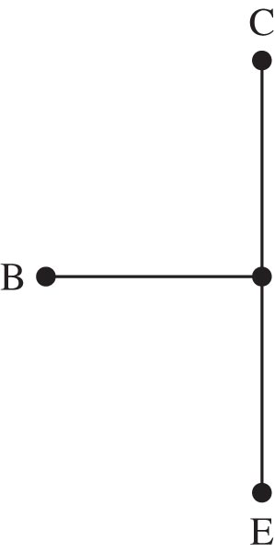
Ideal model of BJT in saturation region.

Slide 35
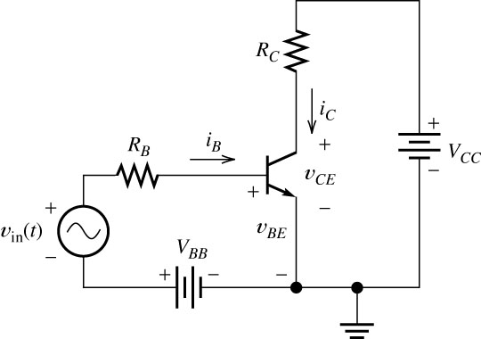
Transistor as an amplifier.

Slide 36
Transistor Amplifier Basics
i_{b}
0
+
I_{B}
=
i_{B}

Slide 37
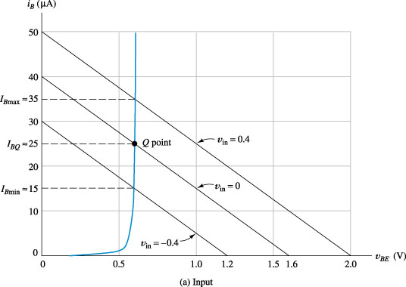
Load-line analysis

Slide 38
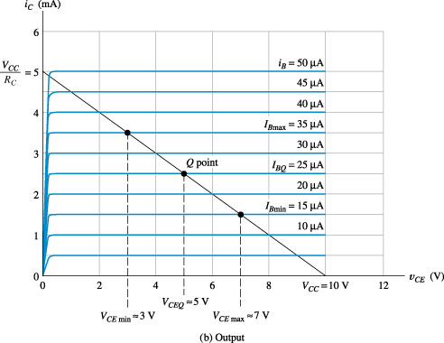
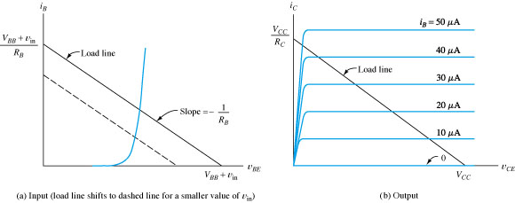
Load-line analysis of the amplifier

Slide 39
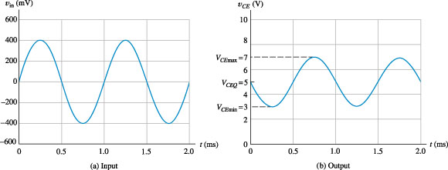
Voltage waveforms for the amplifier

Slide 40
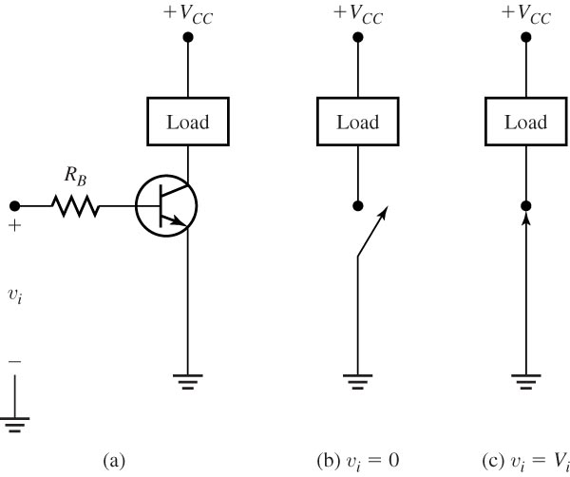
BJT switch using an NPN transistor.

